Slide 1

ADABOOST ALGORITHM
REGRESSION

Slide 2

ADA BOOST (ADAPTIVE BOOSTING)
It is called Adaptive Boosting as the weights are re-assigned to each instance, with higher weights assigned to incorrectly predicted instances.
AdaBoost Algorithm works in a way that merges many weak learners based on a weightage into a strong learner.

Slide 3
DIAGRAM
It consists of a sequential series of models, each one focus on the errors of the previous one, trying to improve them
Weight 3
Weakness
MODEL 1
MODEL 2
MODEL 3
MODEL N
Weakness
Weakness
Weight N
Weight 1
Weight 2

Slide 4
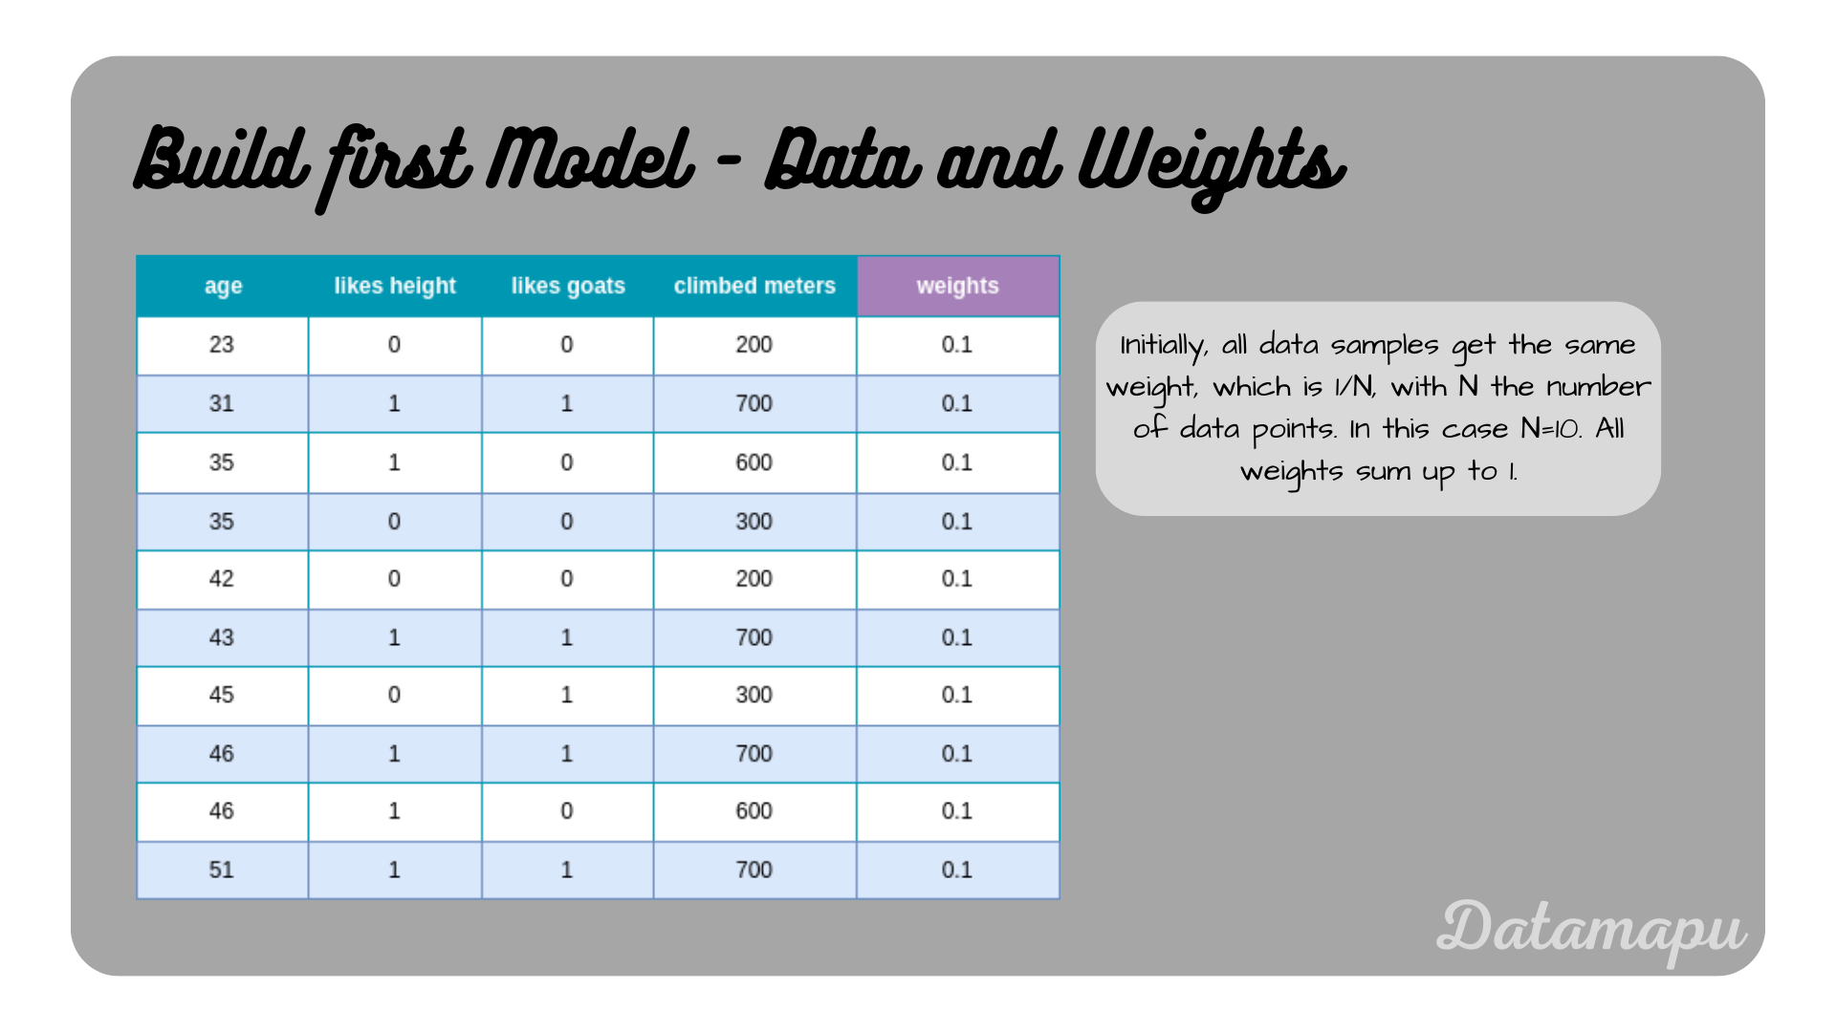
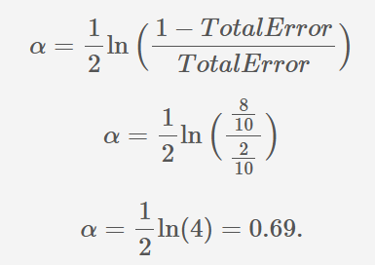
WORKFLOW
1.Fit a model to the initial dataset with equal weights
2.Make predictions and calculate the influence (α) of the fitted model.
Initially all the data samples get the same weight is 1/N, whereas N is the number of data points. Here the weight assigned is 1/10 = 0.1
The influence of a model on the final prediction depends on its error, here 8 samples are correctly predicted.
Image_source: https://datamapu.com/posts/classical_ml/adaboost_example_reg/

Slide 5

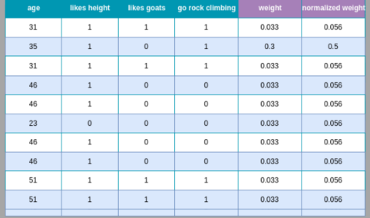
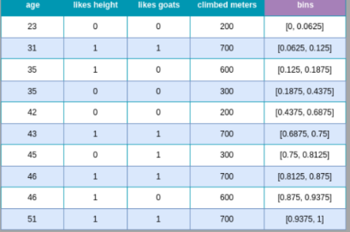
3. Adjust the weights of the data samples.
4. Create a weighted dataset.
Updated weights based on the results of the first weak learner(table on the left side)
Bins for the individual samples based on the weights
New weight is calculated with the old or previous weight of that sample and exponential component of influence in previous step
Image_source: https://datamapu.com/posts/classical_ml/adaboost_example_reg/

Slide 6
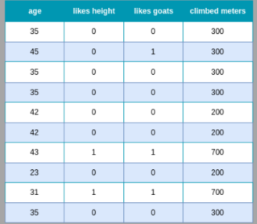
5. Fit a model to the new dataset
Modified dataset from bootstrapping the original dataset based on the weights and bins
Repeat steps 2 to 5 d times, where d is the number of final weak learners of which the ensemble model is composed
Image_source: https://datamapu.com/posts/classical_ml/adaboost_example_reg/

Slide 7
PROS AND CONS
ADVANTAGES | DISADVANTAGES
Improved Accuracy | Sensitivity to noisy data
Easy Implementation | Computational costs
Versatility | Dependency on weak learners
Robustness to overfitting | Limited Interpretability

